Slide 1
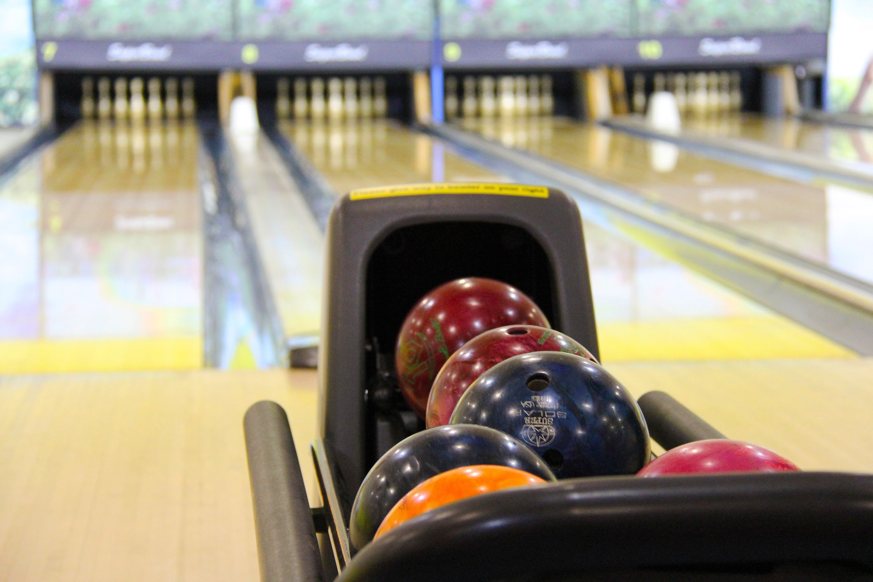

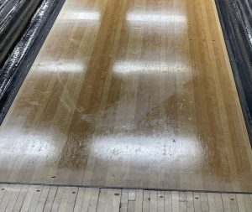
Spring 2023 Season Review

Slide 2

48th Season
4th Here at St. John!

Slide 3
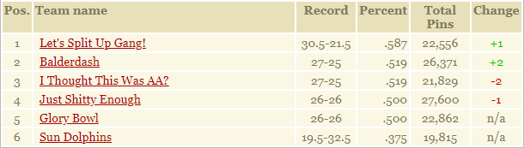
Standings (Mid-April)

Slide 4
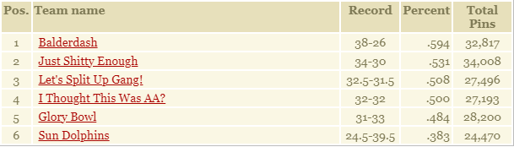
6th Place

Slide 5





Sun Dolphins
6th Place ($80)
Captain: Ryan
MVB: Scott (JC)
New Best Games
  JC (144) +4
  Ryan (231) +10
  Scott (244) +54
New Best Series
  JC (400) +56
  Scott (508) +21
New Best Avg
  JC (107) +13
  Scott (144) +5
Sweep vs. Swept: 1-5
Best Quote: “I’m sorry we’re always the drunkest team!” -A version of Sisco that can’t say, “Fire Marshal”
Team Superlatives:
  Most likely to forget a personal item
  Most likely to have no recollection of the previous week

Slide 6
5th Place

Slide 7
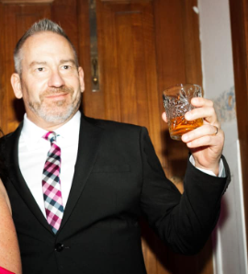



Glory Bowl
5th Place ($80)
Captain: Kent
MVB: Brett (Kent & Nicholas)
New Best Games
  Nicholas (210) +16
New Best Series
  Nicholas (508) +21
New Best Avg
  Kent (171) +2
  Brett (172) +10
Sweep vs. Swept: 2-2
Best Quote: “Where is Colin when we need him?”- Kent after being embraced by Jeremy
Team Superlatives:
  Most likely to hide from Jeremy
  Most likely to have a vacancy

Slide 8
4th Place

Slide 9


I Thought This Was AA?
4th Place ($100)
Captain: AJ
MVB: AJ (Scoot)
New Best Games
  Jim (198) +31
New Best Series
  Nathan (466) +6
New Best Avg
  Nathan (137) +3
  Jim (128) +6
Sweep vs. Swept: 5-4
Best Quote: “You can take your cheese stick curse and shove it up Scoot’s Ass” -A somewhat upset AJ
Team Superlatives:
  Most likely to sweep
  Most likely to doodle on the score sheet

Slide 10
3rd Place

Slide 11


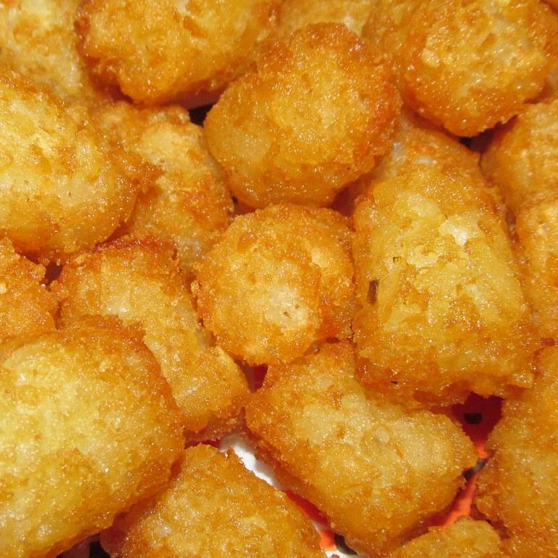


Let’s Split Up Gang!
5th Place ($120)
Captain: JoAnne
MVB: Tott (Chris)
New Best Games
  Jeremy (207) +8
New Best Series
  N/A
New Best Avg
  N/A
Sweep vs. Swept: 3-3
Best Quote: “JoAnne, he’s got a dirtier boob than you.”- Jeremy, concerned about JoAnne’s cleanliness
Team Superlatives:
  Most likely to need a perma sub
  Most likely to sexualize an everyday conversation

Slide 12
2nd Place

Slide 13



Just Shitty Enough
2nd Place ($160)
Captain: Seth
MVB: John (Carl)
New Best Games
  Nick (279) +11
New Best Series
  N/A
New Best Avg
  Nick (183) +3
Sweep vs. Swept: 4-2
Best Quote: “If you get a strike, I’m going to punch Nick in the face” -Seth during a frustrating night for all
Team Superlatives:
  Most likely to bowl on lanes 1&2
  Most likely to mount Scoot

Slide 14
The Champs

Slide 15

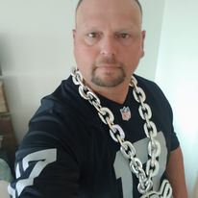
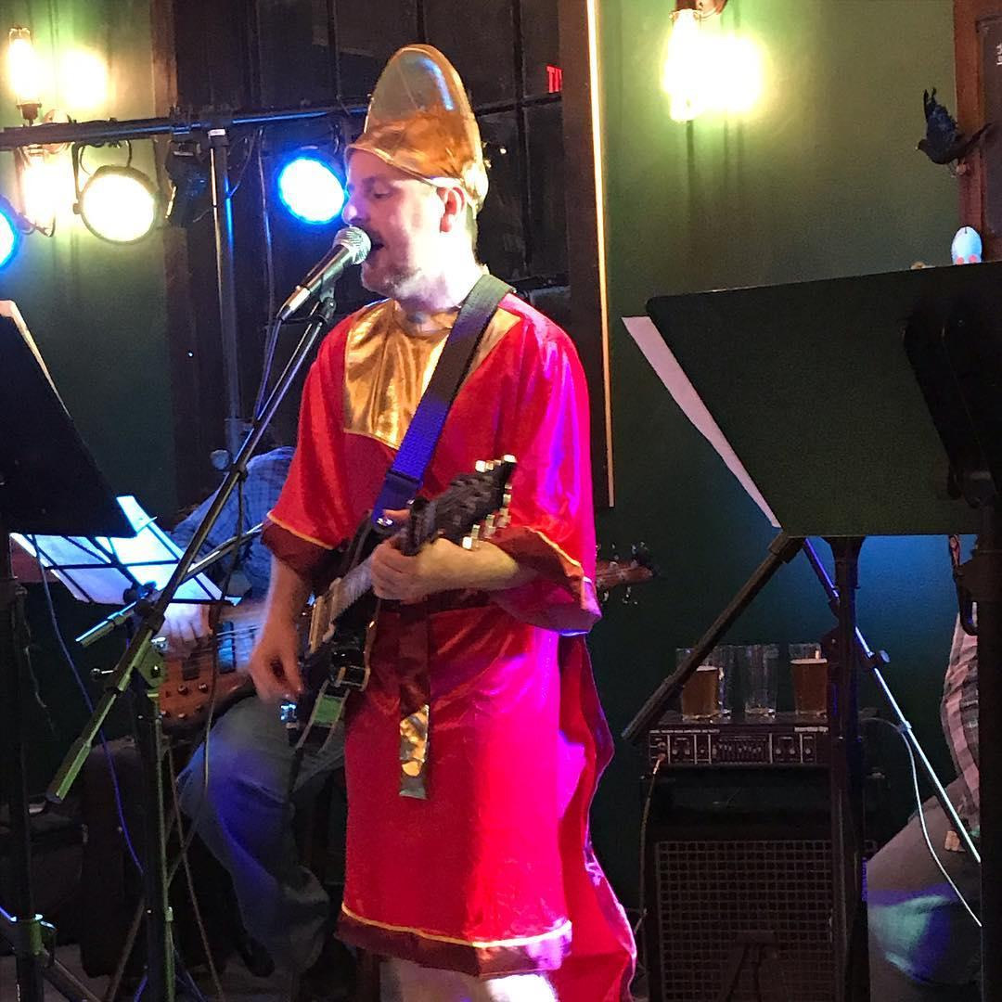
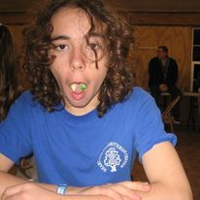
Balderdash
1st Place ($200)
Captain: Dennis
MVB: Gordon (Matt)
New Best Games
  Ben (265) +16
New Best Series
  N/A
New Best Avg
  N/A
Sweep vs. Swept: 4-3
Best Quote: “Hey Scoot, 1&2 suck”- Matt every week reminding Scoot about the love for lanes 1&2
Team Superlatives:
  Most likely to need a reminder to go bowl
  Most likely to show-up late

Slide 16
Season Awards
High Series Scratch: Nick Kinney 669 ($20) / JoAnne Barber 478 ($20)
High Game Scratch: Ben Spencer 265 ($20)
High Series Handicap: Ryan Sisco 749 ($10)
High Game Handicap: James Tott 265 ($10)
#1 Power Ranked Bowler: Brett Affolter ($20)
  Runner-up: Scoot
#1 H2H: AJ Hoffman at 60.579% ($20)
  Runner-up: Gordon at 58.718%
#1 Power Ranked Team: Balderdash (Runner-up: Just Shitty Enough)

Slide 17
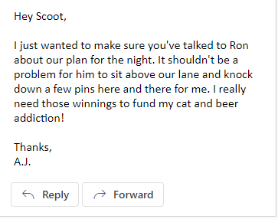
Tournament of Champions!!!

Slide 18
Tournament of Champions!!! (Actually)
Champ: AJ ($75)
Runner-up: Gordon ($50)
Everyone else ($25)

Slide 19
People’s Choice (So Scoot Says)
Rookie of the Season: Chris Lenz
  Runner-up: Doug Lenz
Seth Gunderson Captain of the Season: Dennis Walling
  Runner-up: JoAnne Barber
Carl Goetz Defensive Bowler: Matthew Taylor
  Runner-up: Michael Gordon
Ian Goetz Underdog: Ryan Sisco & Scott Thompson
  Runner-up: Chris Lenz
Bob Brunker/Rob Kaszuba Sportsmanship: Kent Harms
  Runner-up: Ray Scott & Scott Thompson

Slide 20
People’s Choice (So Scoot Says) Cont.
Emily Podhajsky Sportsmanship Award: JoAnne Barber
  Runner-up: Jeremy
Pat Searcy Life of the Party: Scott Thompson
  Runner-up: Ryan Sisco
Sub of the Season: Doug Lenz
  Runner-up: Chris Lenz
Favorite Team to Roll Against: Sun Dolphins
  Runner-up: Glory Bowl
Most Feared Team to Roll Against: Lanes 1&2…..I mean Balderdash
  Runner-up: Just Shitty Enough

Slide 21
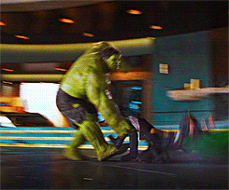
Hulk Smash Awards
Most Seats, Ball Returns, and Walls Hit
  Winner: Carl Goetz
  Runner-up: AJ Hofmann
Most Hats Thrown
  Winner: Clayton Burrow
  Runner-up: Ryan Sisco

Slide 22
Most Valuable Bowler
Popular Vote: Nick Kinney and Matthew Taylor
  Runner-up: Ben Spencer
Actual MVB: Brett Affolter, responsible for 10 wins! ($50)
  Runner-up: Kent and Nicholas tied for 8 wins each

Slide 23
Fun Facts
Carl Goetz crossed the 1,500 games bowled in our league mark last month; he now sits at 1,512 total games.
Matthew Taylor crossed the 150 league career 200+ game mark this season and now sits at 159 200+ games.
Despite his heroic first game of the season, AJ Hofmann only managed to land at #14 in Biggest Sandbaggers of All Time. Among current bowlers he still trails Dennis Walling, Nick Kinney, John Boren, Aaron Barber, and all-time leader Matthew Taylor in this category.
JoAnne Barber, Jeremy Varnell, and James Tott finally broke their career-long First Place drought in week 13 of this season.
Balderdash is the lowest Power Ranked Champion (129th) since Spring of 2009.

Slide 24
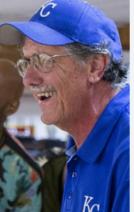
Thank you to the incredible St. John Staff!
Kenny, Alex, Joe, Nick, and Ron

Slide 25
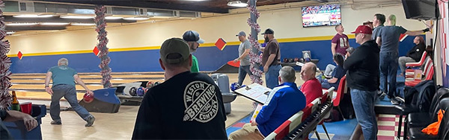
Next Season: August 22
Thank you all for a great season

