Slide 1

Spring 2024 Season Review

Slide 2

50th Season
6th Here at St. John!

Slide 3
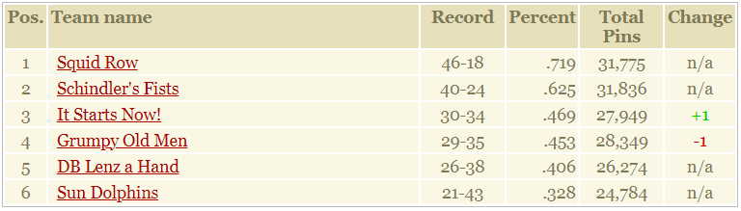
6th Place

Slide 4







Sun Dolphins
6th Place ($100)
Captain: Ryan
MVB: Clayton
New Best Games
  N/A
New Best Series
  N/A
New Best Avg
  N/A

Slide 5
5th Place

Slide 6






DB Lenz a Hand
5th Place ($100)
Captain: JoAnne
MVB: Doug
New Best Games
  Dustin (178) +2
New Best Series
  N/A
New Best Avg
  N/A

Slide 7
4th Place

Slide 8


Grumpy Old Men
4th Place ($100)
Captain: AJ
MVB: AJ
New Best Games
  Nathan (213) +11
New Best Series
  Nathan (490) +4
New Best Avg
  Nathan (147) +10
  AJ (174) +7

Slide 9
3rd Place

Slide 10





Glory Bowl It Starts Now!
3rd Place ($120)
Captain: Nicholas
MVB: Brett
New Best Games
  Brett (235) +5
  Kent (257) +14
New Best Series
  Brett (606) +10
  Kent (683) +46
New Best Avg
  Kent (173) +2
  Brian (110) +1
  Nicholas (149) +10
  Carl (114) +2

Slide 11
2nd Place

Slide 12






Schindler’s Fists
2nd Place ($160)
Captain: Seth
MVB: Seth
New Best Games
  N/A
New Best Series
  Buck Nasty (447) +1
New Best Avg
  Nick (185) +2

Slide 13
The Champs

Slide 14








Squid Row
1st Place ($200)
Captain: Dennis
MVB: Matt
New Best Games
  Chris (224) +15
New Best Series
  N/A
New Best Avg
  N/A

Slide 15
Some memorable Sisco Quotes….Probably
Week 13, Game 2, Frame 10: “I’ve finally figured it out again. I’m on a roll.”
“DID YOU THROW MY SHIT ON THE FLOOR?!”
“Oh, she’s real mad at me now. I went out with a bunch of the twin peaks waitresses last night.”
Week 13, Game 3, Frame 3: “Fuck this game.”

Slide 16
Season Awards
High Series Scratch: Kent Harms 683 ($20) / JoAnne Barber 427 ($20)
High Game Scratch: Matthew Taylor 262 ($20)
High Series Handicap: Michael Gordon 741 ($10)
High Game Handicap: Seth Gunderson 283 ($10)
#1 Power Ranked Bowler: Matthew Taylor ($20)
  Runner-up: AJ Hofmann
#1 H2H: Ben Spencer at 60.564% ($20)
  Runner-up: Dennis Walling at 60.150% (Actual: Matthew Taylor at 67.322%)
#1 Power Ranked Team: Squid Row (Runner-up: Schindler’s Fists)

Slide 17

Tournament of Champions!!!
Champ: Scott Thompson ($75)
Runner-up: Matthew Taylor ($50)
Honorable Mentions ($25)
  Brett Affolter
  Carl Mueller
  Chris Windham
  Dennis Walling
  Doug Lenz
  Jim Koger
This year’s tournament of champions ended in one of the most exciting spectacles in the past several years of the league, as Scott triumphed over Matt in a roll-off for the championship!

Slide 18
People’s Choice
Rookie of the Season: Buck Nasty
  Runner-up: Dennis’s Reconstructed Leg
Seth Gunderson Captain of the Season: Dennis Walling
  Runner-up: Seth Gunderson
Carl Goetz Defensive Bowler: Matthew Taylor
  Runner-up: Kent Harms
Ian Goetz Underdog: Scott Thompson
  Runner-up: Nathan Burrows
Bob Brunker/Rob Kaszuba Sportsmanship: Scott Thompson
  Runner-up: Matthew Taylor

Slide 19
People’s Choice Cont.
Emily Podhajsky Sportsmanship Award: JoAnne Barber
  Runner-up: None
Pat Searcy Life of the Party: Scott Thompson
  Runner-up: Ryan Sisco
Sub of the Season: Dustin Schmeltz
  Runner-up: Nick Kinney
Favorite Team to Roll Against: Sun Dolphins
  Runner-up: Glory Bowl It Starts Now!
Most Feared Team to Roll Against: Squid Row
  Runner-up: Schindler’s Fists

Slide 20
Most Valuable Bowler
Popular Vote: Matthew Taylor
  Runner-up: Kent Harms
Actual MVB: Matt Taylor, responsible for 10.5 wins! ($50)
  Runner-up: Seth Gunderson, 10 wins

Slide 21
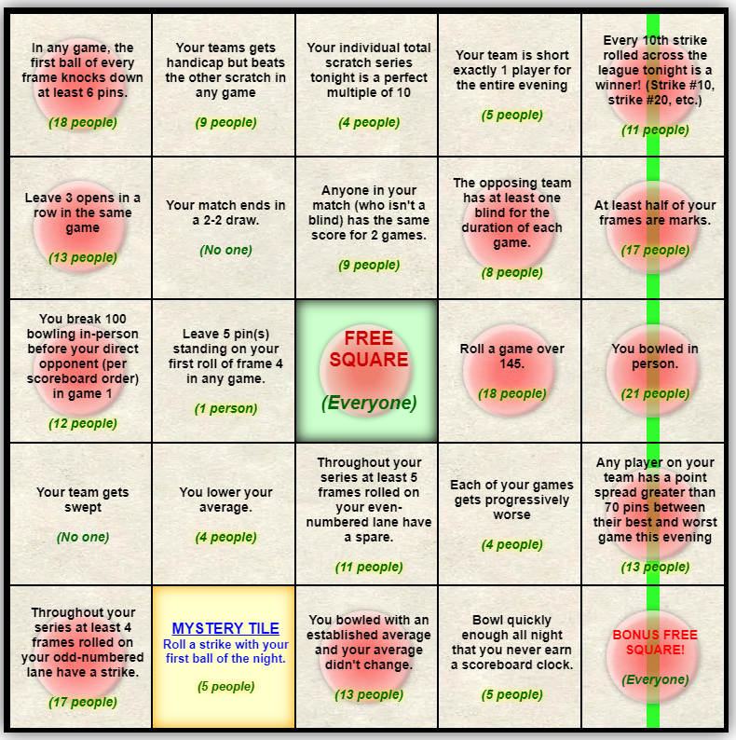

Bingo!
Most Bingos: Ben Spencer and Doug Lenz (6)
  Runner-up: AJ Hofmann and Dennis Walling (5)
Overall Points: AJ Hofmann (212)
  Runner-up: Ben Spencer (207)
Total Tiles: AJ Hofmann (192)
  Runner-up: Ben Spencer (185)

Slide 22
Fun Facts
Dennis Walling and Matthew Taylor both crossed 100,000 career points in this league this season:
  Dennis earned his 100,000th point in Week 12, game 3, frame 10, roll 2 and now sits at 102,120 career points.
  Matthew earned his 100,000th point in Week 13, game 1, frame 2, roll 1 and now sits at 102,267 career points.
Kent Harms has climbed up to become the 17th best bowler in league history to never win a championship -- or third best among current-era bowlers. (James Tott and Dustin Schmeltz both slightly edge him.)
This season Seth Gunderson passed Freda Schroeder to have the 5th highest number of games rolled in league history: 1,418. (Ahead of him still are 3 more retired bowlers and Scoot. Once Scoot kicks the bucket Seth will still have to roll 12 more seasons to achieve #1.)
In week 2 of this season, Chris Windham earned his 100th win. at the end of his 152nd game. This makes Chris tied with Nick Kinney for 5th place among all league bowlers in history to reach their 100th win the quickest.
Ben Spencer has made his way onto the list of the Top 25 Bowlers with the Most 200+ games, debuting at #24 on the list with 75 200+ games.
Speaking of 200+ games rolled, we had 72 this season. That's a big improvement over last Fall where we only had 56 with essentially the same teams.
In week 12, game 3 between It Starts Now! and Squid Row was the 7th highest-scoring game in league history to be decided by a single pin, with Starts beating Squids 739-738.
And of course we all already know what happened in week 14: Brett Affolter plunged from 223 to 91 (132 points) from game 1 to game 2. This is the 5th largest change in score between games and the 3rd biggest drop in league history.

Slide 23
Hall of Fame Inductions
There are no Hall of Fame inductions. On the merits of your performances, none of you deserve it.
This concludes the Hall of Fame section of this season’s presentation.

Slide 24


Thank you to the incredible St. John Staff!

Slide 25

Next Season: August 27 (Probably)
Thank you all for a great season

