Slide 1
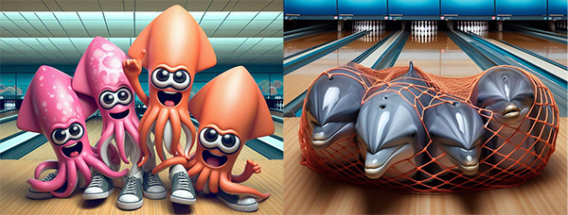
Fall 2024 Season Review

Slide 2
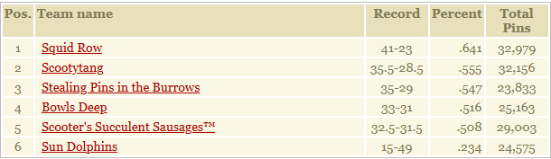
6th Place

Slide 3
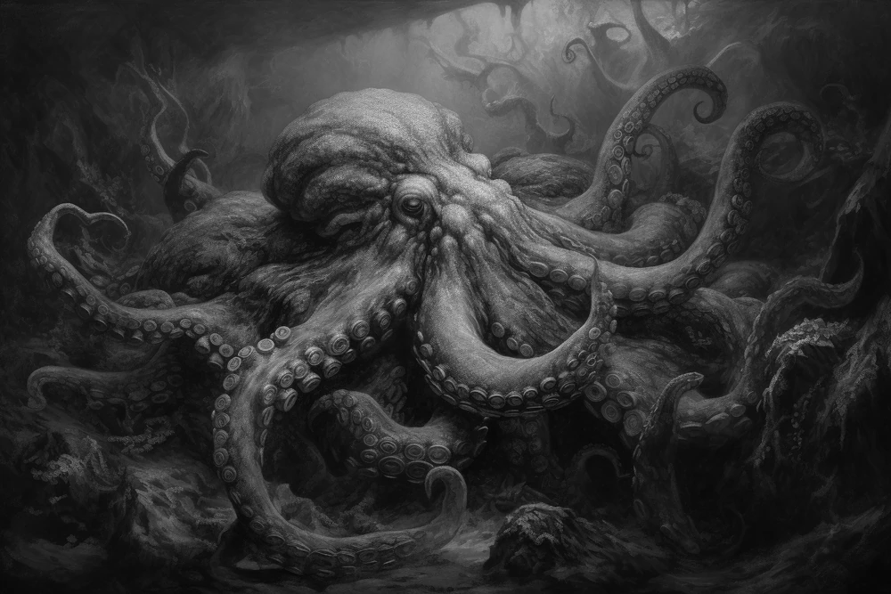







Sun Dolphins
Captain: Ryan
MVB: Scott
New Best Games
  N/A
New Best Series
  N/A
New Best Avg
  Scott Thompson: 150 (+1)

Slide 4
5th Place

Slide 5



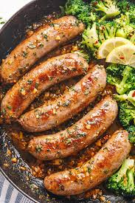
Scooter’s Succulent Sausages™
Captain: AJ
MVB: Scoot
New Best Games
  N/A
New Best Series
  N/A
New Best Avg
  N/A

Slide 6
4th Place

Slide 7





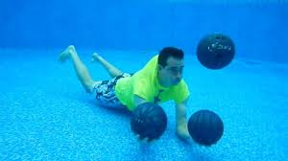
Bowls Deep
Captain: Kent
MVB: Brian / Chris (tie)
New Best Games
  Brian (170) +14
  Carl (181) +9
  Nicholas (220) +10
New Best Series
  Brian (427) +24
  Nicholas (537) +29
New Best Avg
  Brian (112) +2
  Carl (115) +1

Slide 8
3rd Place

Slide 9



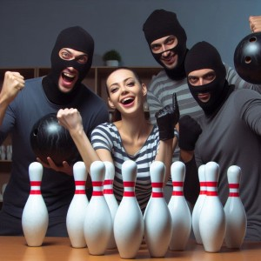
Stealing Pins in the Burrows
Captain: JoAnne
MVB: Nathan
New Best Games
  Nathan (233) +20
New Best Series
  Nathan (543) +53
New Best Avg
  N/A

Slide 10
2nd Place

Slide 11





Scootytang
Captain: Seth
MVB: Aaron
New Best Games
  N/A
New Best Series
  Buck Nasty (476) +29
New Best Avg
  N/A

Slide 12
The Champs

Slide 13








Squid Row
Captain: Dennis
MVB: Dennis
New Best Games
  N/A
New Best Series
  Chris (556) +30
New Best Avg
  Chris (148) +1

Slide 14
Season Awards
High Series Scratch: Matthew Taylor 688 / JoAnne Barber 409
High Game Scratch: Seth Gunderson 247
High Series Handicap: Nathan Burrows 744
High Game Handicap: Ryan Sisco 260
#1 Power Ranked Bowler: Dennis Walling
  Runner-up: Nathan Burrows
#1 H2H: Nathan Burrows at 60.535%
  Runner-up: Aaron Barber at 58.548% (Actual: Dennis Walling at 61.259%)
#1 Power Ranked Team: Squid Row (Runner-up: Scootytang)

Slide 15

Tournament of Champions!!!
Champ: Nathan Burrows
Runner-up: Scoot Murdock
Honorable Mentions
  AJ Hofmann
  Buck Nasty
  Chris Lenz
  Dennis Walling
  JoAnne Barber
  Seth Gunderson

Slide 16
People’s Choice
Rookie of the Season: Chris Hagan
  Runner-up: Chris Lenz Right Arm
  Second Runner-up: Nathan Burrows Left Arm
Seth Gunderson Captain of the Season: Dennis Walling
  Runner-up: AJ Hofmann
Carl Goetz Defensive Bowler: Matthew Taylor
  Runner-up: Aaron Barber
Ian Goetz Underdog: Brian Schaben
  Runner-up: Nathan Burrows
Bob Brunker/Rob Kaszuba Sportsmanship: Matthew Taylor
  Runner-up: Kent Harms

Slide 17
People’s Choice Cont.
Emily Podhajsky Sportsmanship Award: JoAnne Barber
  Runner-up: None
Pat Searcy Life of the Party: Scott Thompson
  Runner-up: Ryan Sisco
Sub of the Season: Matt Jaklevich
  Runner-up: Tim Christensen
Favorite Team to Roll Against: Sun Dolphins
  Runner-up: Bowls Deep
Most Feared Team to Roll Against: Scootytang
  Runner-up: Squid Row

Slide 18
Most Valuable Bowler
Popular Vote: Matthew Taylor
  Runner-up: Dennis Walling
Actual MVB: Nathan Burrows, responsible for 13 wins!
  Runner-up: Aaron Barber, 10 wins

Slide 19
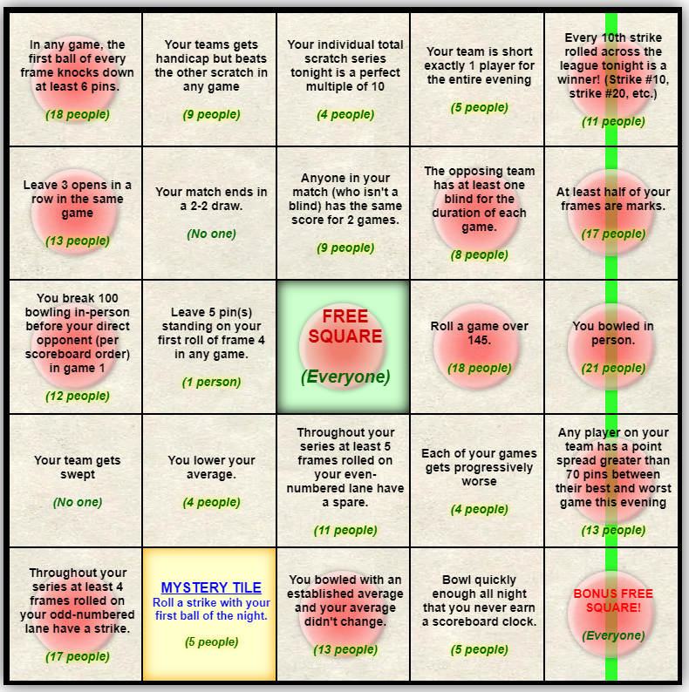

Bingo!
Most Bingos: Seth Gunderson (7)
  Runner-up: Kent Harms (6)
Overall Points: Dennis Walling (207)
  Runner-up: Seth Gunderson (202)
Total Tiles: Dennis Walling (189)
  Runner-up: Ben Spencer (184)

Slide 20
Fun Facts
Kent Harms remains the best bowler who has not won a championship.
Aaron Barber rolled his league 250th 200+ game on October 22, with his 203 in game 3 against the Sun Dolphins. He now stands at 254 200+ games. And Matthew Taylor rolled his 200th league 200+ game that very same day, with his 225 in game 2 against Bowls Deep.
This was missed last season, but Matthew Taylor actually earned his 50th league 600+ series on the final night of bowling last Spring. He now stands at a count of 56.
Seth Gunderson came just 75 pins shy of crossing the 250,000 career pins mark and would have crossed it easily last Tuesday had he not had to miss game 1 for a grade school Christmas pageant. At least that's something he can look forward to accomplishing in his first game next season as long as he doesn't sandbag too much.

Slide 21
Hall of Fame Inductions
There are no Hall of Fame inductions. On the merits of your performances, none of you deserve it.
This concludes the Hall of Fame section of this season’s presentation.

Slide 22
Bowling for…..fun?
Kenny has offered a “for fun & practice” bowling session on Jan. 14th at 6:30
Good chance to practice/experiment/relax on the our home lanes
Cost for the lanes would be zero IF we run up a high enough bar tab to make it worth their time

Slide 23
Bowling for…..money?
A vote will be sent out over the winter break to address possible changes to the cost of bowling. Options are:
Full Prize Fund: Increase of $35 per person ($28 for a team of 5). All teams would win prize money at the end of the season
Partial Prize Restoration: Increase of $20 per person (16 for a team of 5). Top 2-3 teams win money. All other prizes would be restored at a reduced rate.
No Prize Restoration: Dues remain the same. Prizes would remain as we see them today

Slide 24
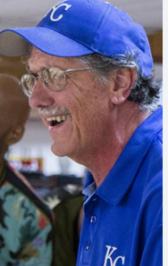
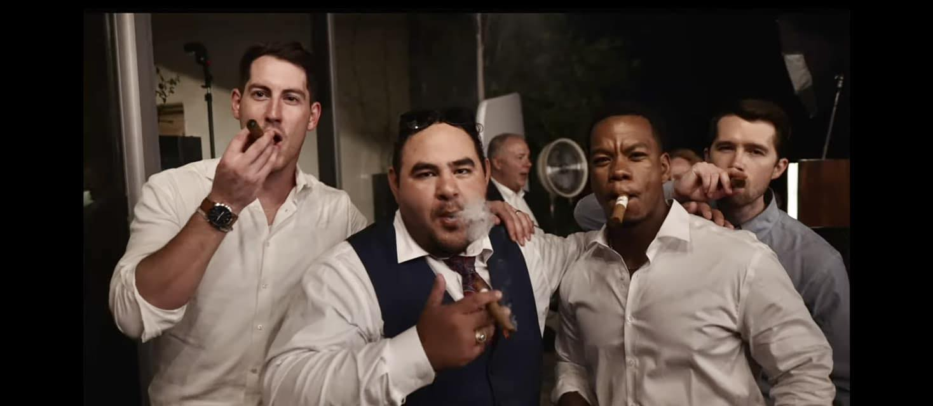

Thank you to the incredible St. John Staff!

Slide 25
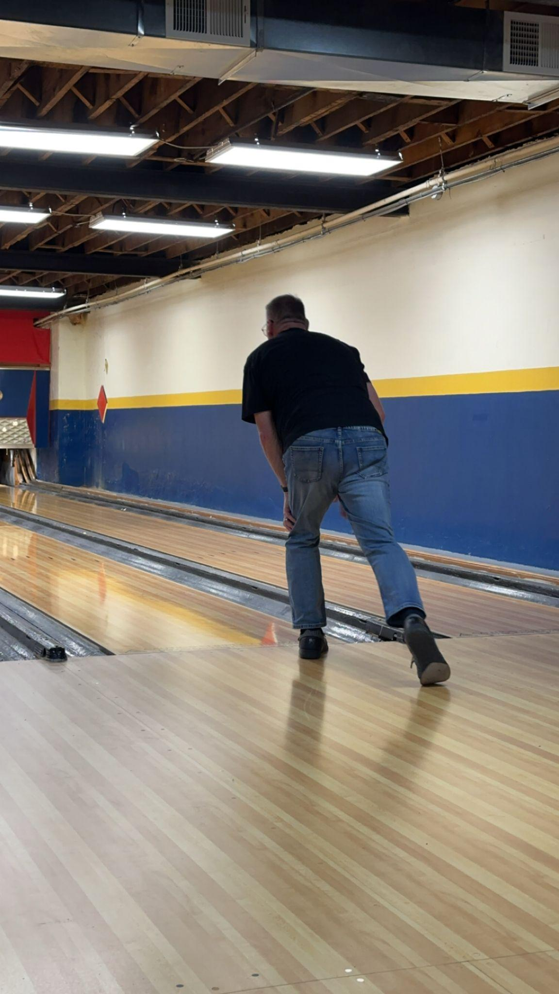
Next Season: January 28
Thank you all for a great season

