Slide 1

Spring 2026 Season Review

Slide 2

54th Season
10th Here at St. John!

Slide 3
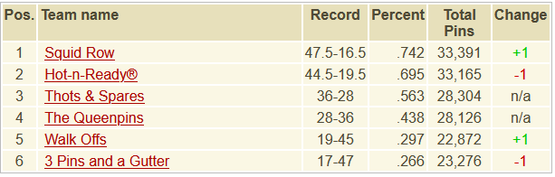
6th Place

Slide 4


3 Pins and a Gutter
6th Place ($100)
Captain: JoAnne
MVB: JoAnne
New Best Games
  Jesse (143) +14
New Best Series
  Jesse (343) +1
New Best Avg
  Jesse (100) +1
Jesse
(100)
Jeremy
(122)
Nathan
(135)
JoAnne (127)

Slide 5
5th Place

Slide 6


Walk Offs
5th Place ($100)
Captain: Brian
MVB: Chris
New Best Games
  Mike (191) +27
New Best Series
  Kurt (421) +5
  Mike (463) +48
New Best Avg
  Kurt (126) +9
  Mike (122) +7
Brian
(105)
Carl
(113)
Chris
(128)
Kurt
(126)
Mike
(122)

Slide 7
4th Place

Slide 8

The Queenpins
4th Place ($100)
Captain: Dustin
MVB: Jon
New Best Games
  N/A
New Best Series
  N/A
New Best Avg
  N/A
Sisco
(133)
Lindsay
(109)
Jon
(172)
Dustin
(171)

Slide 9
3rd Place

Slide 10

Thots & Spares
3rd Place ($120)
Captain: AJ
MVB: AJ
New Best Games
  Scott (253) +6
New Best Series
  N/A
New Best Avg
  N/A
Jim
(125)
Tim
(135)
Scott
(159)
AJ
(170)

Slide 11
2nd Place

Slide 12

Hot-N-Ready®
2nd Place ($160)
Captain: Seth
MVB: Ian
New Best Games
  Ian (244) +11
New Best Series
  Ian (663) +15
New Best Avg
  Ian (187) +8
Jim
(125)
Tim
(135)
Scott
(159)
AJ
(170)

Slide 13
The Champs

Slide 14








Squid Row
1st Place ($200)
Captain: Dennis
MVB: Matt
New Best Games
  N/A
New Best Series
  N/A
New Best Avg
  Chris (158) +2
Chris
(158)
Ben
(178)
Dennis
(174)
Matt
(185)

Slide 15
Season Awards
High Series Scratch: JoAnne Barber 441 / Ian Estey 663 ($20)
High Game Scratch: Lindsay Sargent 146 / Dennis Walling 268 ($20)
High Series Handicap: Jon Little 723 ($10)
High Game Handicap: Scott Murdock 289 ($10)
#1 Power Ranked Bowler: Matthew Taylor ($20)
  Runner-up: Scott Murdock
#1 H2H: Ben Spencer at 65.742% ($20)
  Runner-up: Ian Estey
#1 Power Ranked Team: Squid Row (Runner-up: Hot-N-Ready®)
Ben Spencer Most Improved Bowler Award
  In-Season: Mike Fitzgerald +13 since week 4 ($20)
  Since Last Season: Seth Gunderson +191 ($20)

Slide 16

Tournament of Champions!!!
Champ: Mike Fitzgerald ($75)
Runner-up: Jon Little ($50)
Honorable Mentions ($25)
  Ian Estey
  Jesse Sauerbrei
  Kurt Fredrickson
  Matthew Taylor
  Scott Murdock
  Tim Deddens

Slide 17
People’s Choice
Rookie of the Season: Jon Little (shocker)
  Runners-up: Lindsay and Jesse
Seth Gunderson Captain of the Season: Dennis Walling
  Runner-up: Seth Gunderson
Carl Goetz Defensive Bowler: Ian Estey
  Runner-up: Matthew Taylor
Ian Goetz Underdog: Tim Deddens
  Runner-up: Kurt Fredrickson
Bob Brunker/Rob Kaszuba Sportsmanship: Carl Mueller
  Runner-up: Brian Schaben

Slide 18
People’s Choice Cont.
Emily Podhajsky Sportsmanship Award: Lindsay Sargent
  Runner-up: JoAnne Barber
Pat Searcy Life of the Party: Jeremy Varnell
  Runner-up: Chris Hagan
Sub of the Season: None! There were no subs this season.
  Runner-up: N/A
Favorite Team to Roll Against: Walk Offs
  Runner-up: The Queenpins / Hot-n-Ready®
Most Feared Team to Roll Against: Hot-n-Ready®
  Runner-up: Squid Row

Slide 19
Most Valuable Bowler
Popular Vote: Ian Estey
  Runner-up: Dennis Walling
Actual MVB: Ian Estey, responsible for 12 wins! ($50)
  Runner-up: Matt Taylor, 9 wins

Slide 20
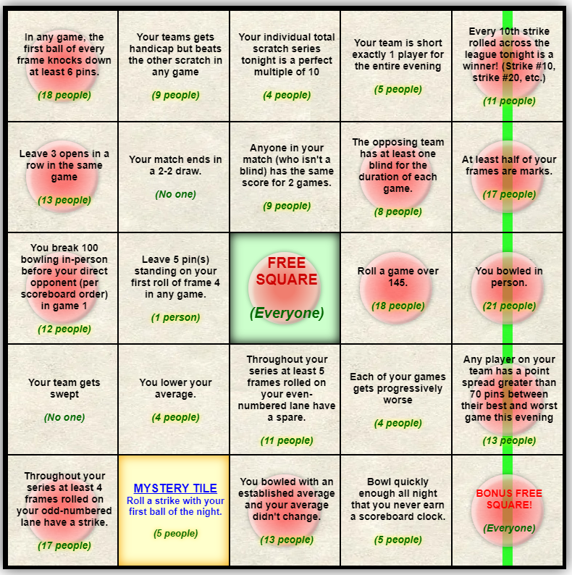

Bingo!
Most Bingos: Ben Spencer (6)
  Runner-up: Buck Nasty, Ian Estey, Scott Murdock (5)
Overall Points: Matt Taylor (209)
  Runner-up: Scott Murdock (208)
Total Tiles: Matt Taylor (194)
  Runner-up: Scott Murdock (191)

Slide 21
Fun Facts
In Week 11 JoAnne Barber crossed 100,000 career pins, with Jeremy Varnell doing the same a few rolls later.
Seth Gunderson rolled his 250th career 200+ game in Week 6. He now sits at 254.
Matt Taylor’s two 600+ series this season brought his total count to 61, good for 5th place in league history. He could pass Aaron Barber’s 63 next season.

Slide 22
Hall of Fame Inductions
There are no Hall of Fame inductions. On the merits of your performances, none of you deserve it.
This concludes the Hall of Fame section of this season’s presentation.

Slide 23
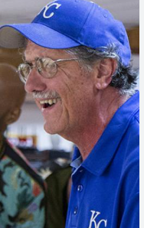

Thank you to the incredible St. John Staff!

Slide 24

Next Season Begins August 18th (Probably)
Thank you all for a great season

